Slide 1
Presentation Title
Presenter or Author Name
Additional details may be added here
Title or role description

Slide 2
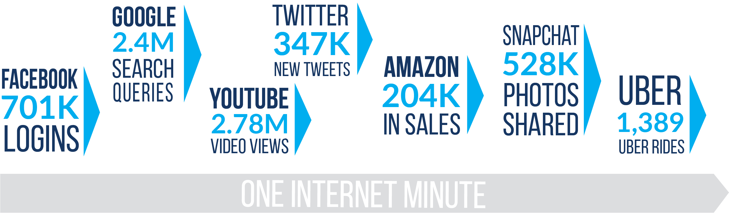
The reality—
2016: What happens in an internet minute?

Slide 3
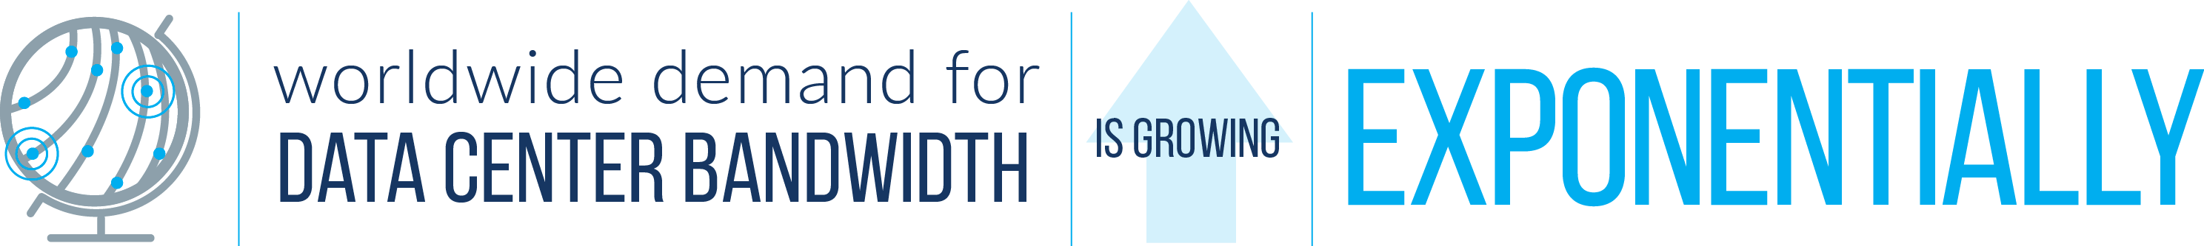
The result
—it’s not changing anytime soon.

Slide 4

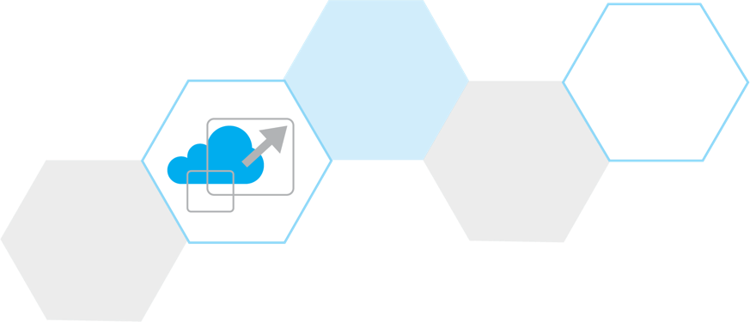
The challenge
Adapt your data center infrastructure in order to:
Increase equipment port count and fiber density
Support faster lane capacities
Reduce latency
Prepare to migrate to higher speeds

Slide 5

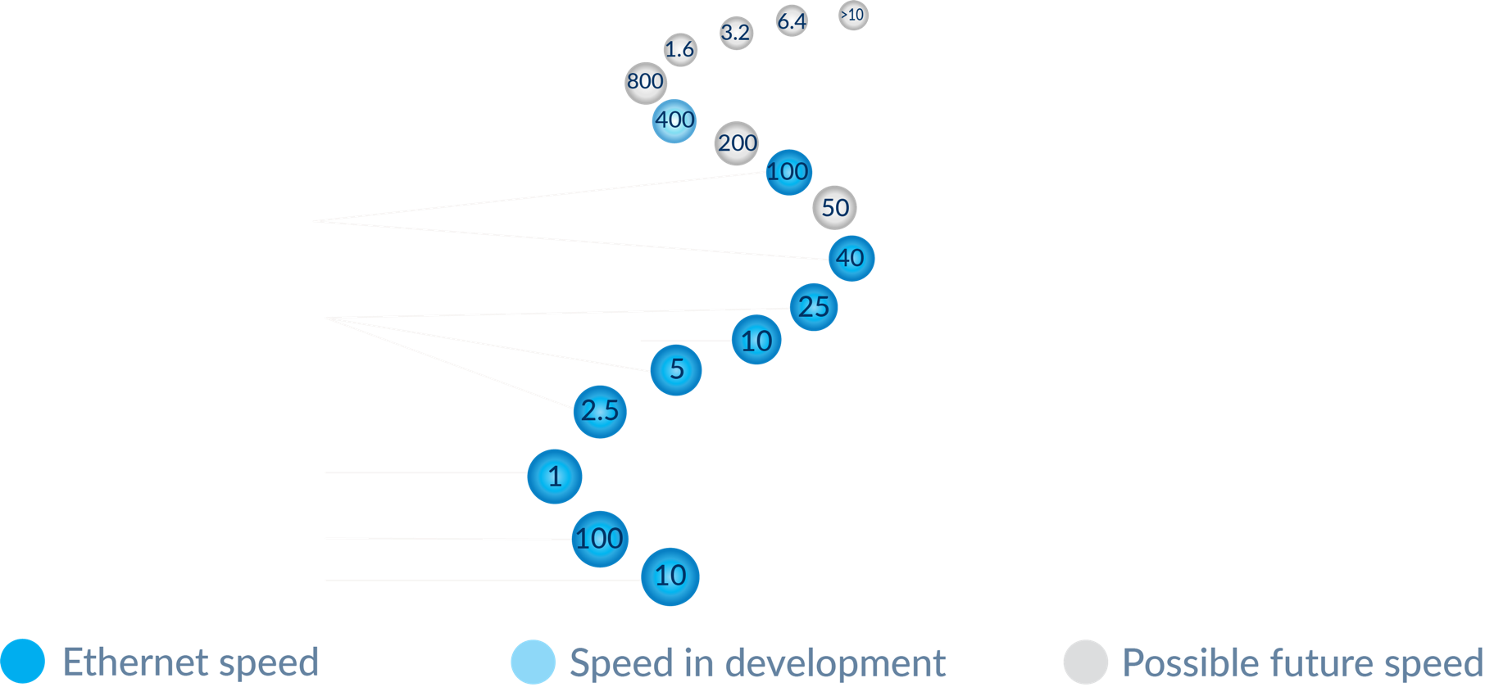
A roadmap exists…
…but the path forward is anything but straight

Slide 6

Which way?
8-fiber, 12-fiber, 24-fiber…which MPO?
25G/50G is in—40G is on its way out
Optics: duplex, parallel or both?
WBMMF, a game changer

Slide 7
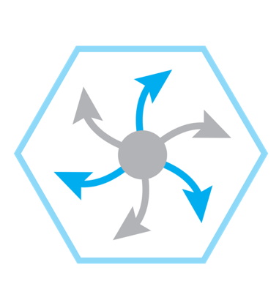
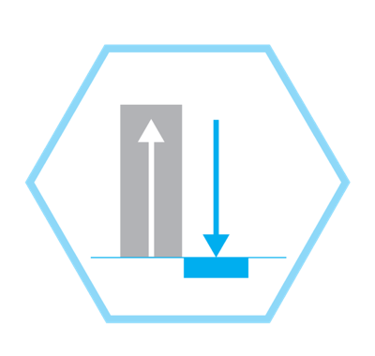
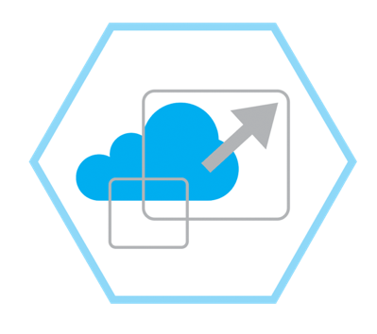
Your network infrastructure must be:
Agile and
flexible
High density and Ultra-low loss
Cloud friendly

Slide 8

Agile and Flexible
Modularity to support your higher speeds today as well as tomorrow’s new applications and technologies

Slide 9
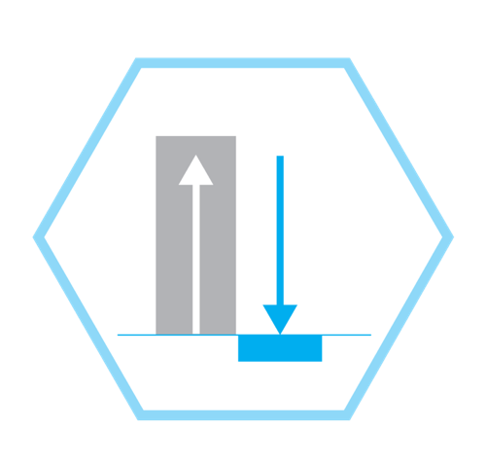
High density and Ultra-low loss
Keeps your growing fiber network accessible and manageable and adaptable for easy scaling

Slide 10
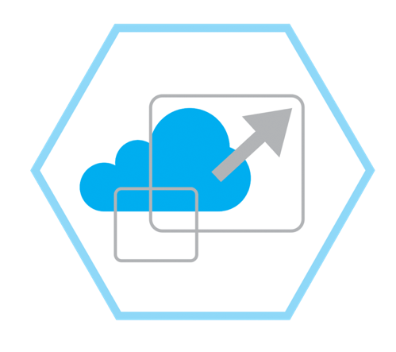
Cloud friendly
Supports your evolving strategies to reduce cost and complexity in the network

Slide 11
CommScope’s
High-Speed Migration Platform
Modular fiber and connectivity building blocks,
network development tools and infrastructure intelligence
for every part of your data center.

Slide 12
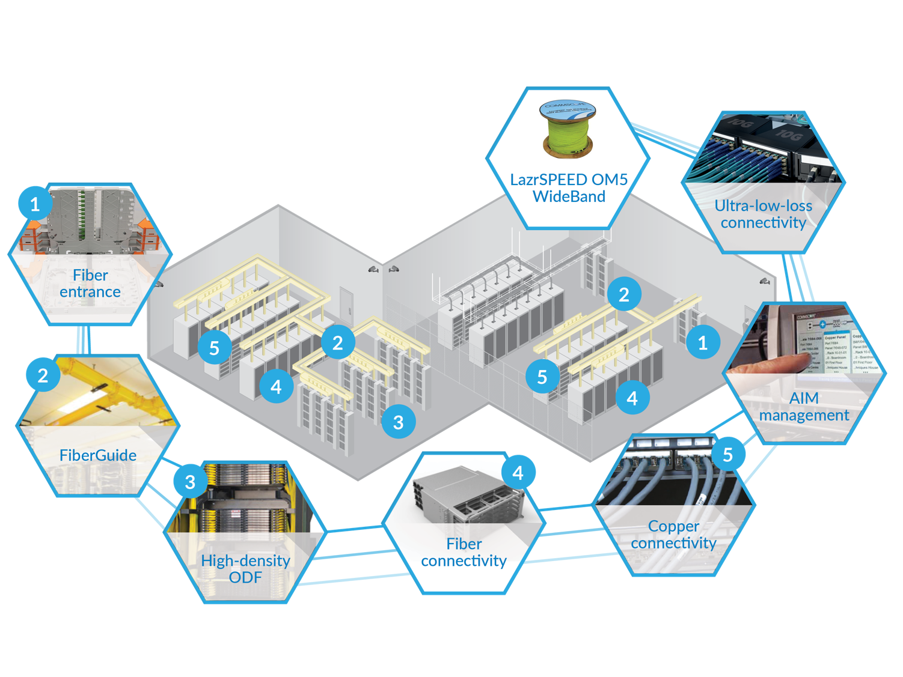
How does high-speed migration tie to our portfolio strategy?
Notes:
Segway (transition) slide

Slide 13
Blueprint for a long-term migration strategy
Create an agile, manageable and fiber-dense infrastructure that can
support higher-speed applications and technologies
as they continue to evolve—scaling easily with minimal disruption.

Slide 14

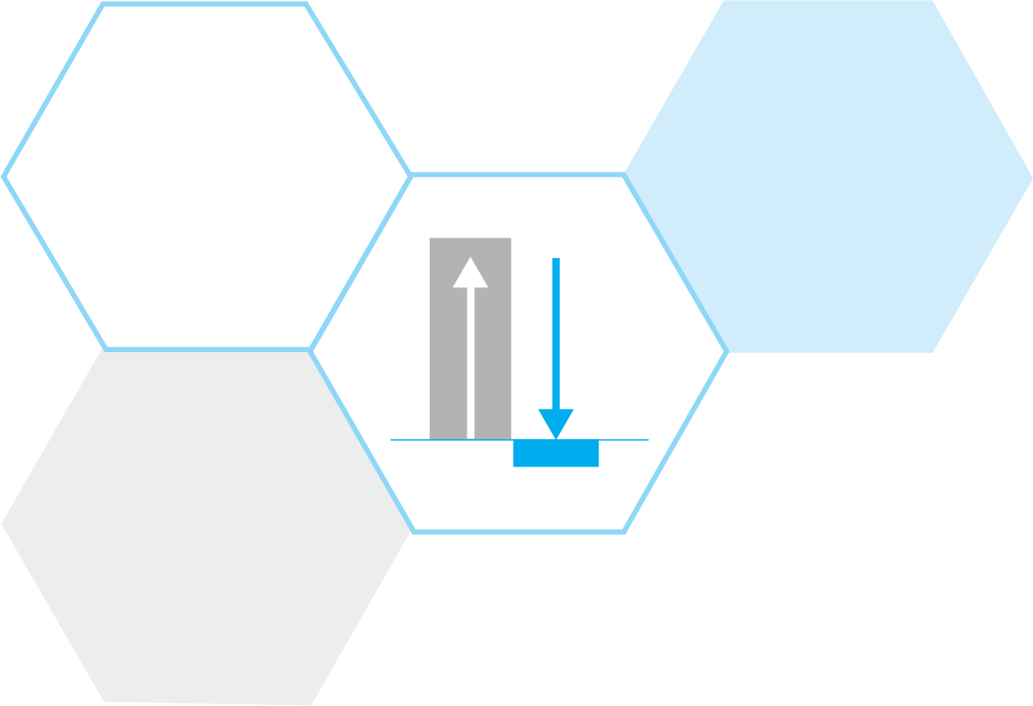
Higher speeds—minimal redesign
Evolve at your own speed with singlemode or multimode optics—modular components support 25-, 40-, 50-, 100-, 400 Gbps and beyond
Increase scalability— OM5 WideBand (MMF) quadruples capacity while maintaining legacy duplex multimode fiber architectures
Support advanced, attenuation-sensitive technologies—end-to-end links with multimode ultra-low-loss fiber solutions

Slide 15

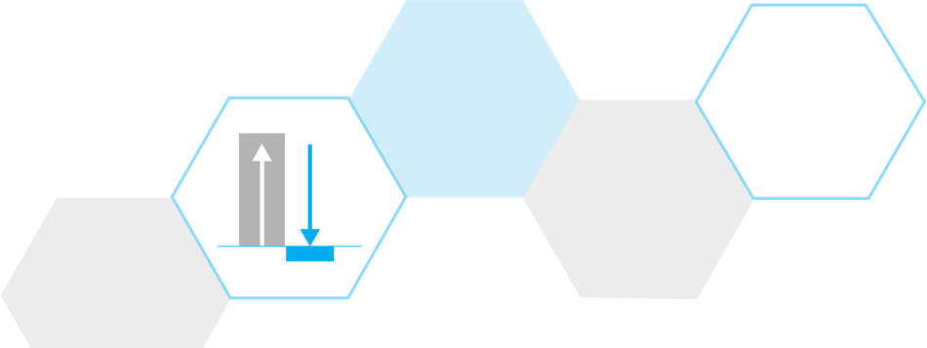
Higher density—easier management
Support the fiber and equipment port density required for leaf-and-spine networks with high- and ultra-high density fiber panels that keep link connections accessible and manageable
Reduce the time, cost and risk of moves, adds, and changes with a more secure and streamlined cable routing system

Slide 16

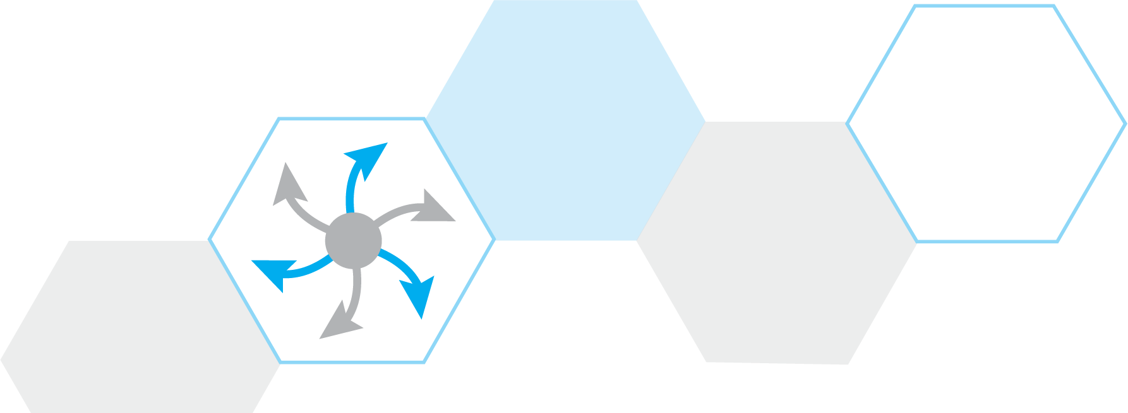
Agile, flexible and future ready
Respond to sudden and unexpected changes with easy to use panels, modules, fiber and connectors
Support emerging applications with optimal fiber configuration with a complete portfolio of single and multimode fiber and connector options for all major MPO fiber configurations
MPO-24
MPO-8
MPO-12

Slide 17

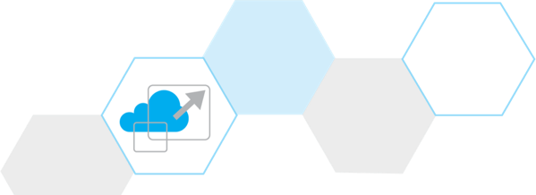
Reducing costs throughout
Lower deployment time and cost with pre-terminated connectivity and plug-and-play installation
Cut fiber counts and increase capacity by a factor of four with wideband-enabled OM5 multimode fiber
Monitor and control the connected environment with available automated infrastructure management that provides real-time visibility of the physical layer and connected devices

Slide 18
High-Speed Migration Components
Building blocks of a solid strategy

Slide 19
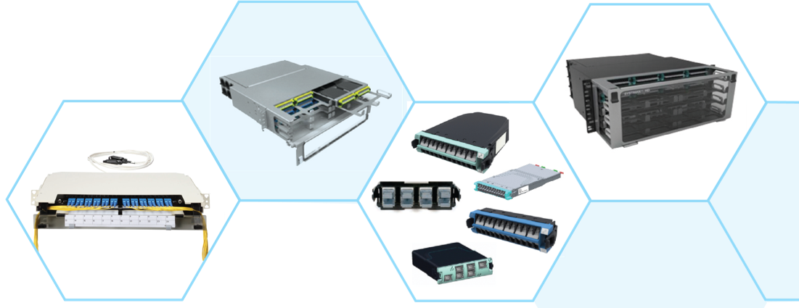
HIGH-SPEED MIGRATION COMPONENTS
Fiber panels
Unique split tray design for open access to all fibers and connections while innovative fiber routing keeps all cables ordered, visible and accessible as they exit the front and rear of the panel
High-density (HD): 48 duplex LC or 32 MPO ports per RU
Ultra-high density (UD): 72 duplex LC or 48 MPO ports per RU
Both support singlemode, OM4 and OM5 multimode
G2 compatible modules and adapter packs
Intelligence—enabled with imVision®!

Slide 20
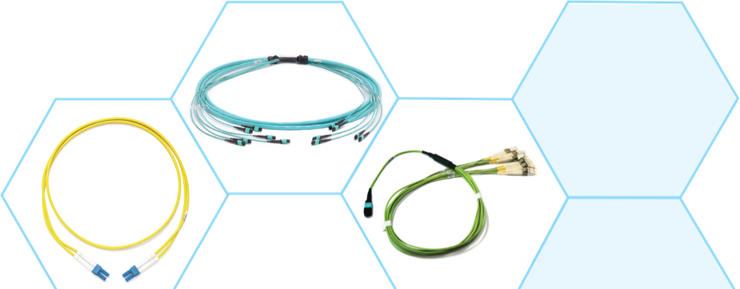
HIGH-SPEED MIGRATION COMPONENTS
Cabling and connectors
Fiber cables
OM5 WideBand multimode: Pioneered by CommScope, it enables shortwave division multiplexing and increases capacity by a factor of four
Ultra-low loss pre-terminated cable: Supports longer link spans and the infrastructure design needed for guaranteed operational availability
G.657.A2 singlemode: Delivers lowest bend losses—for macro- as well as micro-bending
Connectors
Wide range of MPO configurations: 8-, 12- and 24-fiber
24-fiber MPO ensures lowest “first cost” duplex deployment

Slide 21
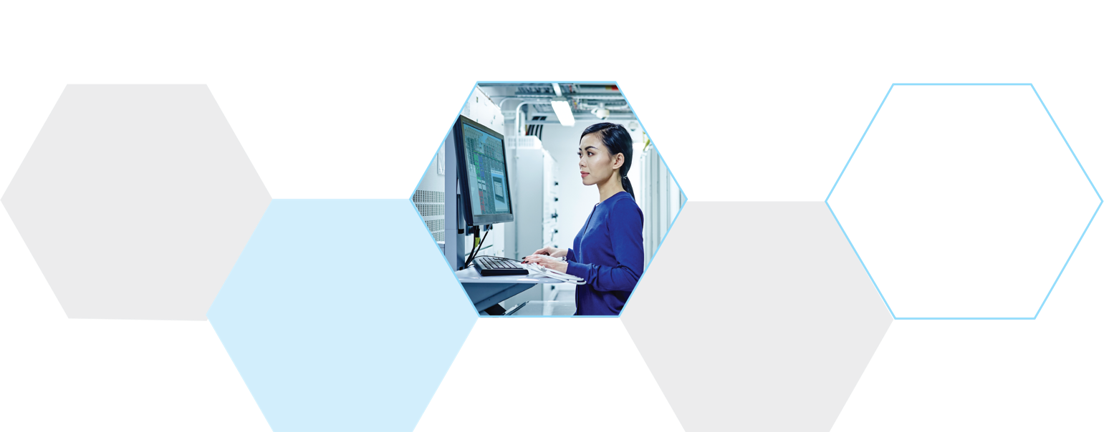
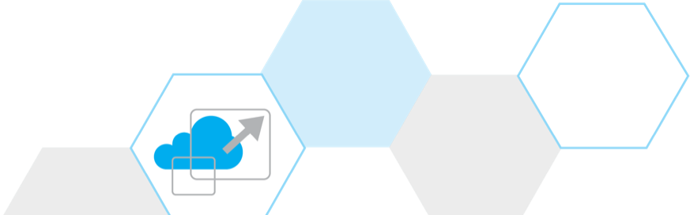
HIGH-SPEED MIGRATION COMPONENTS
Network planning tools
Application support guidelines: Provide the supportable distance limits for any application based on fiber type, connector type and number of connectors
Link loss calculator: Automatically calculates insertion loss limits and provides confirmation of accurate installation
Applications assurance guide: Defines the guaranteed support for high-speed optic applications

Slide 22
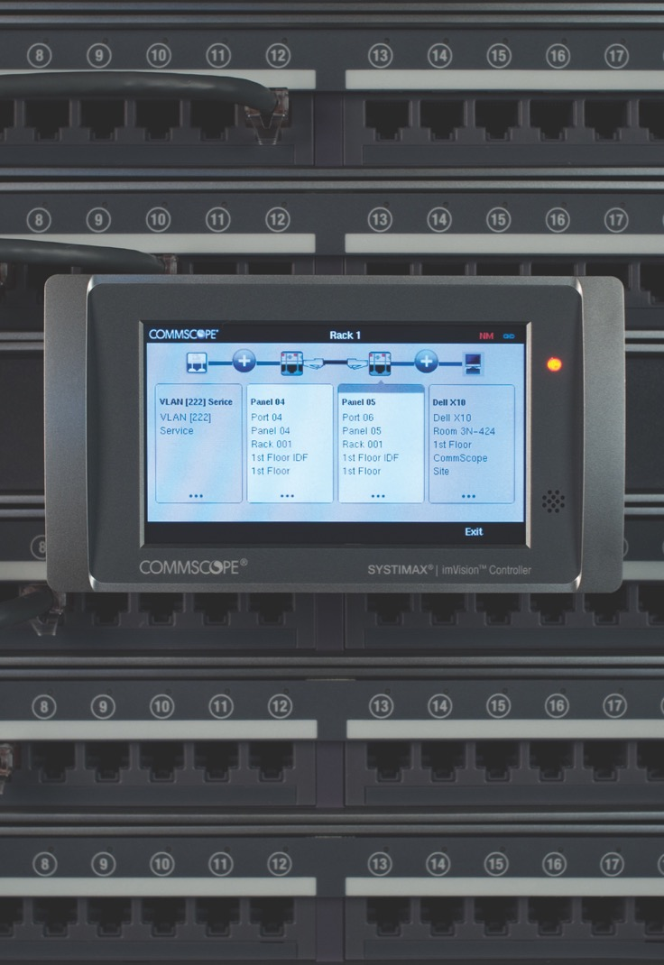
Manage it all with intelligence—imVision®
Faster speeds mean more components, cables and connections—far too many to monitor and manage manually.

Slide 23
Manage it all with intelligence—imVision®
imVision provides automatic real-time tracking of every connection and change in your physical layer, enabling you to:
Handle moves/add/changes more easily
Accelerate mean time to repair
Record all physical layer changes as they occur
Be notified of any unplanned or unauthorized change
Identify unused IT assets and cabling for reuse
imVision intelligence is available as an option with many components in the high-speed migration platform

Slide 24

A continually evolving portfolio
CommScope’s high-speed migration platform is continually adapting and growing as industry standards, applications and technologies evolve.
As an active member of the major global standards bodies, we are driving the trends and technologies shaping the industry.
Rest assured, CommScope can support your higher-speed migration plan, no matter what it involves.

Slide 25


Not just solutions—a solid strategy
More than innovative infrastructure solutions, the high-speed migration platform is a long-term strategy, taking you from where you are today to where you are going tomorrow.
Learn more
commscope.com

Slide 26


